Slide 1

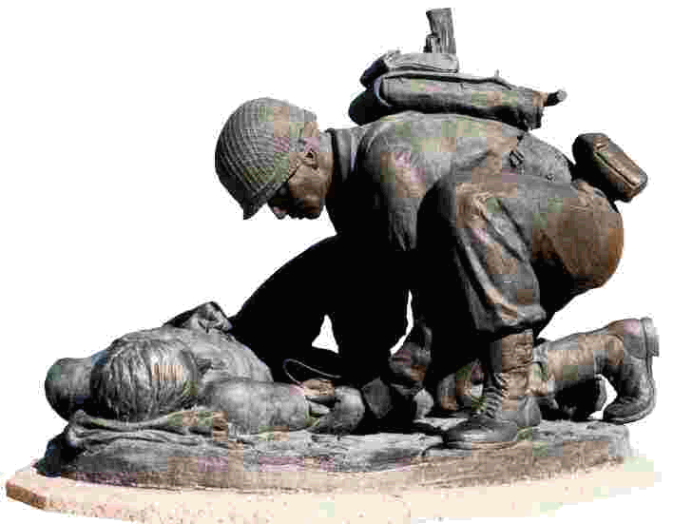
Certificate of Appreciation
62nd medical Brigade (rear)
is hereby granted to
NAME
In recognition of your outstanding service to the Soldiers and Families of 62nd Medical Brigade (Rear). Your continued support and dedication as Senior Advisor of the Family Readiness Group is invaluable and greatly appreciated.
December 2013
CSM’s NAME
CSM, USA
Command Sergeant Major
COMMANDER”S NAME
COL, MS
Commanding

