Slide 1
CUI
JBLM MWR
FoFS Scoreboard, BDE/GRP / 2023-2024
New Points
Existing Points
Bruce Antonowicz, DFMWR, 253-967-5210, bruce.p.antonowicz2.naf@army.mil

Slide 2
CUI
JBLM MWR
FoFS Scoreboard, BN/SQD / 2023-2024
New Points
Existing Points
Bruce Antonowicz, DFMWR, 253-967-5210, bruce.p.antonowicz2.naf@army.mil

Slide 3
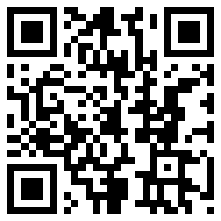
CUI
JBLM MWR
FoFS Scoreboard & Upcoming Events
Leaderboard | BDE/GRP | BTN/SQD
First | 42 MP | 508 MP
Second | 1 MDTF | 13 CCSB
Third | 1-2 SBCT | 504 MP
Full FoFS schedule:
Current Events
CC Bowling
CC Indoor Soccer
Upcoming
wear blue Veterans Day Run
11 November (Wilson Fitness Center)
eSports Super Smash Bros
25 November (Warrior Zone)
Run Rudolph Run
2 December (MWR Fest Tent)
Upcoming cont’d
ASAP Dodgeball Tournament
5-7 December (Wilson Fitness Center)
eSports Call of Duty MW3
9 December (Warrior Zone)
Fitness Resolution Fair
6 January (Wilson Fitness Center)
Partner with Us!
SFRGs/Booster Clubs/POs
Concessions/Food Booth
Winterfest
Bruce Antonowicz, DFMWR, 253-967-5210, bruce.p.antonowicz2.naf@army.mil
3

